Slide 1

Java is easy Presentation
21.11.2016

Slide 2
Today’s Agenda
Knowing the class Scanner: the most modern way to make IO(input/output) in Java
Finding some FIRST class literature to put big and solid grounds for the future
Working with 2D arrays in order to display, organise and calculate our common world better
Career chances and project work: the key for success
The Homework!-> the game 4 in a row (Old but Gold)

Slide 3
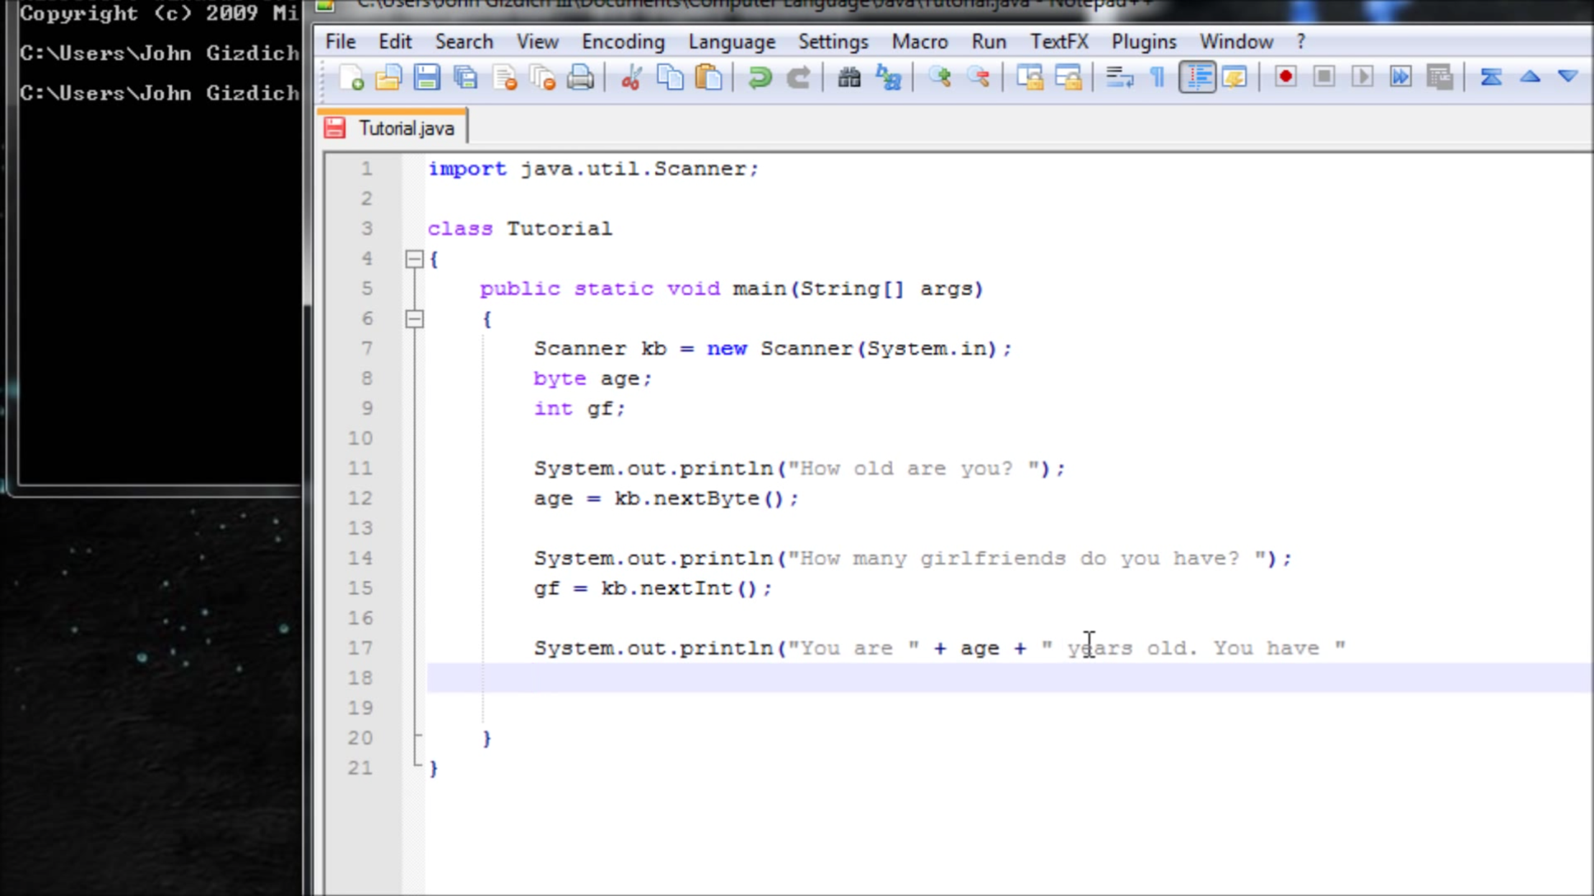
1.Knowing the class Scanner: the most modern way to make IO(input/output) in Java
Simple example:

Slide 4
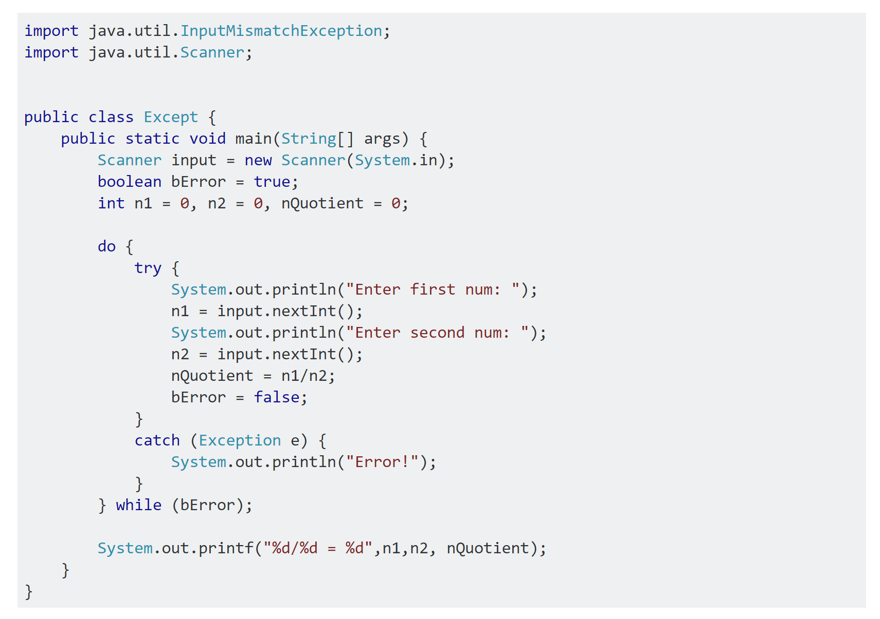
Full example with try/catch block

Slide 5
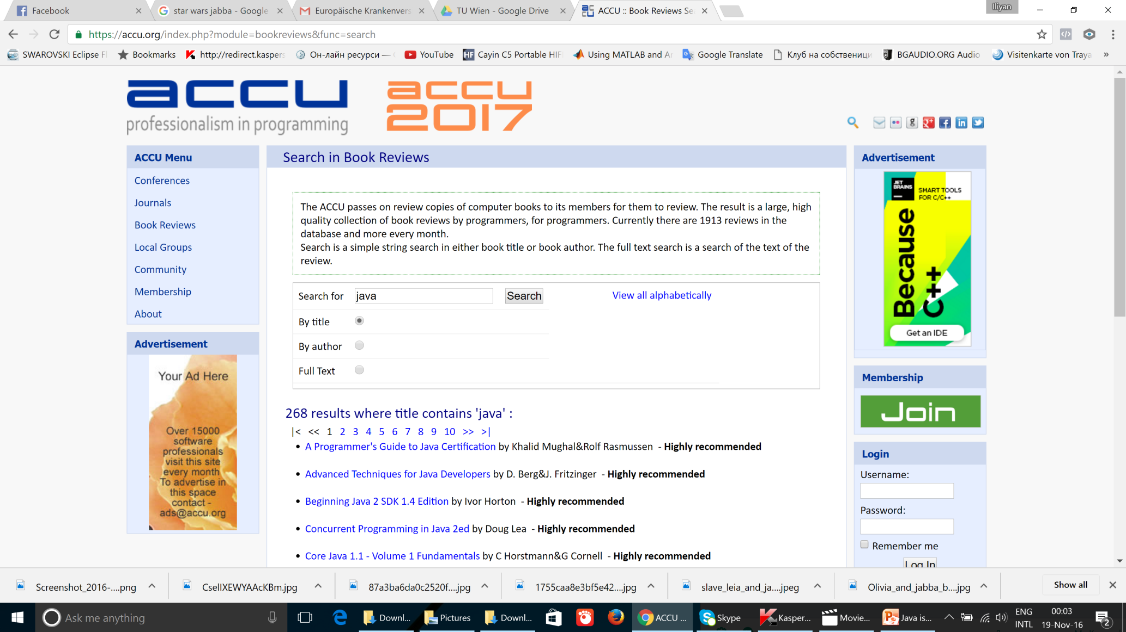
2.Finding some FIRST class literature to put big and solid grounds for the future

Slide 6
3.Working with 2D arrays in order to display, organise and calculate our common world better

Slide 7
4.Career chances and project work: the key for success
Engineers without Borders Austria: http://www.iog-austria.at/welcome/?L=1 for now they are making garden table with solar roof together with refugees, they will need your help for making computer program to record the data from the sensors in it
Infonova: https://www.infonova.com/en/index.html Ecosystems for Smart Life (They are working with Engineers without Borders as well, especially Philipp Pichler, I spoke with him personally so we can communicate with him as well in the future: https://www.xing.com/profile/Philipp_Pichler10 his email is philipp.pichler@infonova.com
https://www.fabasoft.com/en/ Fabasoft: Cloud Solutions for big companies and more
http://www.ranorex.com/?gclid=CMGPuLW_s9ACFXAo0wod0mEOxQ Ranorex: Automatic Testing of your code (but only when your projects become really BIG, not for now)
http://www.karriere.at/jobs/4646173 Allianz needs young specialist in Java. English and German in B2 Level and some IT Degree are a must!

Slide 8
5.The Homework!-> the game 4 in a row (Old but Gold)
import java.util.Scanner;
public class Main{
//global variables
//game board
//creates scanner
Public static void main(String[] args){
//creates board
//tells player how to play
//displays board
//creates boolean to determine status of game
//main game loop
//activates player 1s turn, then prints board
//determines if player 1 has won
//sets flag to false so loop is not repeated if player 1 won
//break to skip player 2s turn if won
//activates player 2s turn, then prints board
//determines if player 1 has won
//sets flag to false so loop is not repeated if player 2 won
// break for consistency
public static void CreateBoard() {
//fills board with '.' for the width and height
public static void PrintBoard() {
//prints the board
public static void DropX(){
//creates a counter
//shows whos turn
//gets input
//checks to see if space is blank, puts X there if it is
//breaks loop after placing
//if space isn't blank, checks to see if one above is
//puts X if blank
//breaks loop after placing
//adds one to counter if the space wasn't blank, then loops again
//checks to see if at end of column
public static void DropO(){

Slide 9
//creates a counter
//shows whos turn
//gets input
//checks to see if space is blank, puts O there if it is
//breaks loop after placing
//if space isn't blank, checks to see if one above is
//puts O if blank
//breaks loop after placing
//adds one to counter if the space wasn't blank, then loops again
//checks to see if at end of column
public static boolean CheckXHorizontal(){
//creates boolean to act as flag
//creates counter
//goes through board horizontally
//if it finds an X, add 1 to counter
// if next piece is not an X, set counter to 0
//if counter is greater or equal to 4, player wins
public static boolean CheckXVertical(){
//creates boolean to act as flag
//creates counter
//goes through board vertically
//if it finds an X, add 1 to counter
// if next piece is not an X, set counter to 0
//if counter is greater or equal to 4, player wins
public static boolean CheckOHorizontal(){
//creates boolean to act as flag
//creates counter
//goes through board horizontally
//if it finds an O, add 1 to counter
// if next piece is not an O, set counter to 0
//if counter is greater or equal to 4, player wins
public static boolean CheckOVertical(){
//creates boolean to act as flag
//creates counter
//goes through board vertically
//if it finds an O, add 1 to counter
// if next piece is not an O, set counter to 0
//if counter is greater or equal to 4, player wins

Slide 10
public static boolean CheckXDiagonalForward(){
//flag
//counter
//check boolean
//checkers
//goes through until an X is found
//if X is found, add one to counter and go into loop
//goes through diagonally looking for Xs
//if X is found, add 1 to counter
//adds 1 to checkers
//if outside of board, break
//if counter is greater or equal to 4, player wins
//resets counter and checkers
public static boolean CheckODiagonalForward(){
//flag
//counter
//check boolean
//checkers
//goes through until an O is found
//if O is found, add one to counter and go into loop
//goes through diagonally looking for Os
//if O is found, add 1 to counter
//adds 1 to checkers
//if outside of board, break
//if counter is greater or equal to 4, player wins
//resets counter and checkers
public static boolean CheckXDiagonalBack(){
//flag
//counter
//check boolean
//checkers
//goes through until an X is found
//if X is found, add one to counter and go into loop
//goes through diagonally looking for Xs
//if X is found, add 1 to counter
//adds 1 to checkers
//if outside of board, break
//if counter is greater or equal to 4, player wins
//resets counter and checkers
public static boolean CheckODiagonalBack(){
//flag
//counter
//check boolean
//checkers
//goes through until an O is found
//if O is found, add one to counter and go into loop
//goes through diagonally looking for Os
//if O is found, add 1 to counter
//adds 1 to checkers
//if outside of board, break
//if counter is greater or equal to 4, player wins
//resets counter and checkers

Slide 11
As a dessert I give you the whole final of the program
public static boolean CheckX(){
//creates flag
boolean flag = true;
//checks all Xs at once, for clearner main loop
if(!CheckXVertical() || !CheckXHorizontal()|| !CheckXDiagonalBack()|| !CheckXDiagonalForward()){
flag = false;
} return flag;
}
public static boolean CheckO(){
//creates flag
boolean flag = true;
//checks all Os at once, for clearner main loop
if(!CheckOVertical() || !CheckOHorizontal() || !CheckODiagonalBack() || !CheckODiagonalForward()){
flag = false;
}
return flag;
}
}

Slide 12

Java advices: Don’t forget to make your homework! ☺

